Slide 1
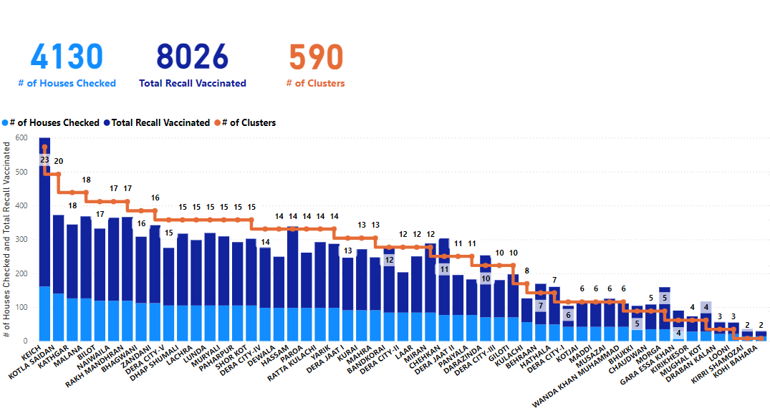
NID OCT 2024 ICM ANALYSIS

Slide 2
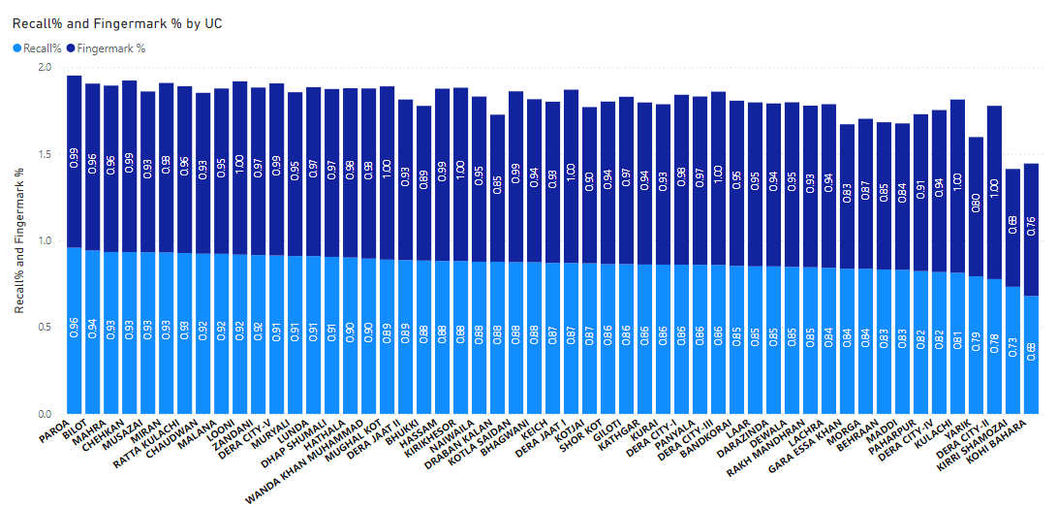
UC WISE %AGE BY RECALL AND FM
88
Recall
95
Fingermark

Slide 3
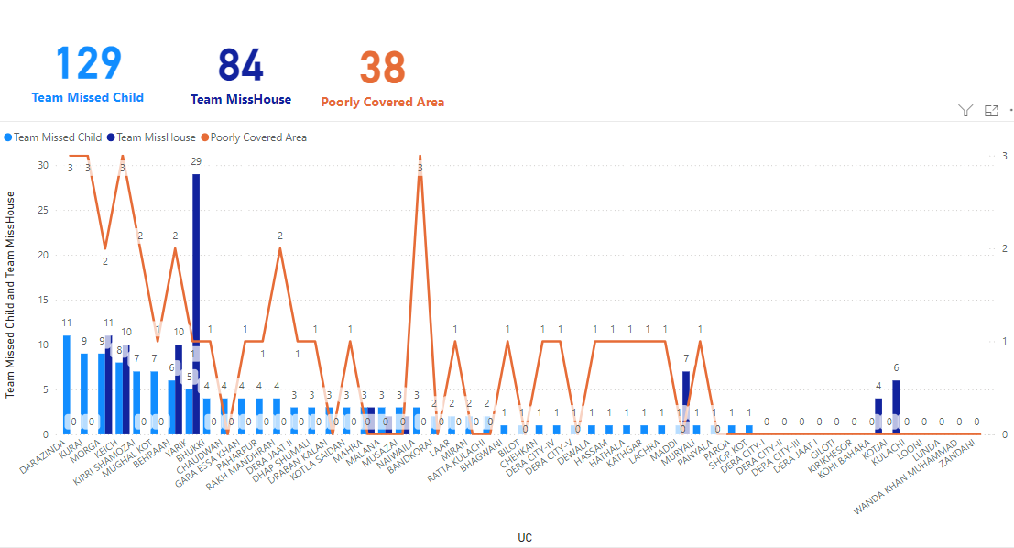
TVBMC AND TEAM DID NOT VISIT HOUSE

Slide 4
ICM HH Clusters Cadre Wise
District | DIKHAN
UCMO | 142
ComNET staff | 8
EPI Coordinator | 2
UCPO / UCSP/ UCDO | 386
TPO/ TDO | 23
Area Coordinator / District Coordinator | 3
Immunization Officer | 3
DSV / ASV | 5
District NSTOP Officer | 4
Federal/Provincial/District Facilitator | 7
TTSP/TUSP | 1
DDHO | 4
CEO/DHO | 2
Grand Total | 590

Slide 5
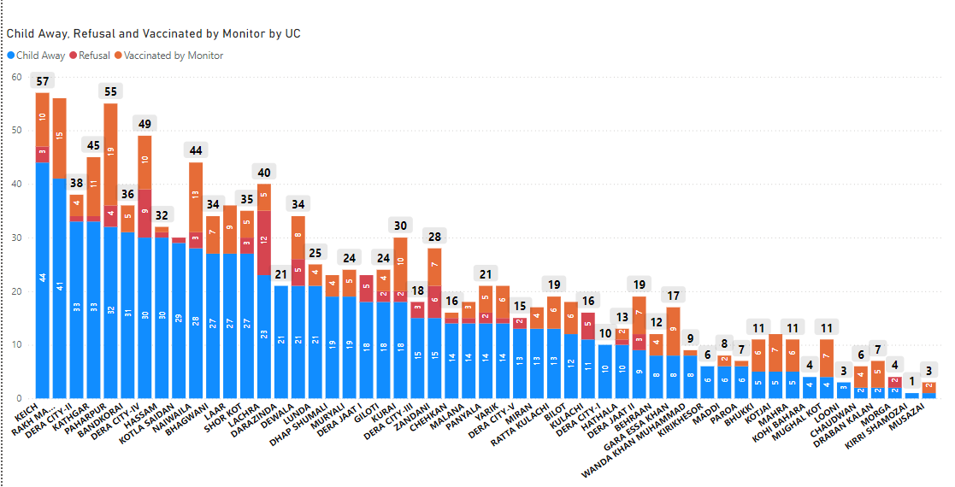
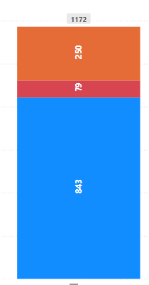
Child Away Refusal and Vaccinated by Monitor UC wise and District wise

Slide 6
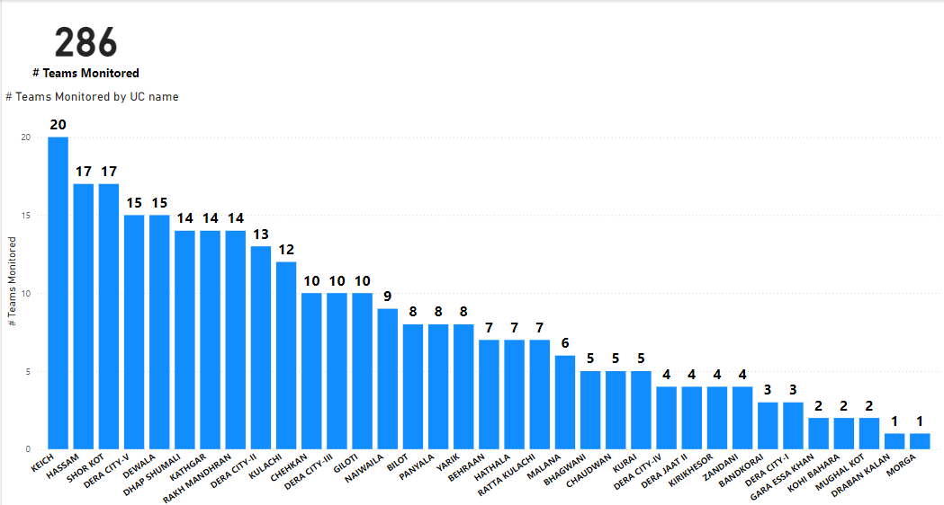
UC Wise # of Team Monitored

Slide 7
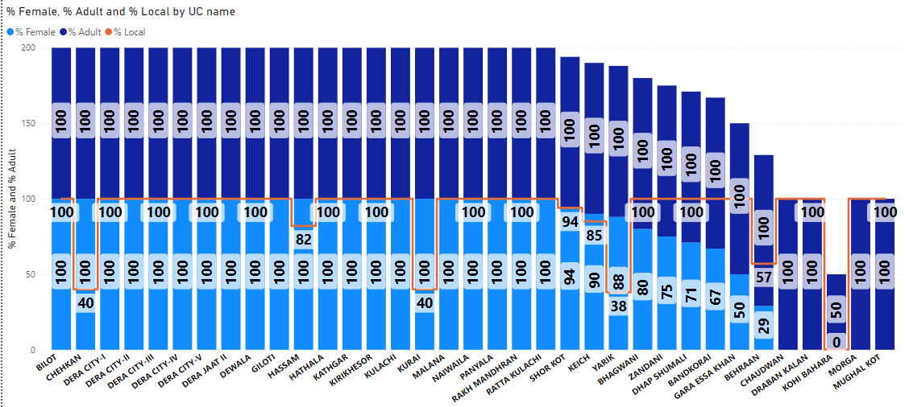
TEAM COMPOSITION AS MONITORED

